Slide 1


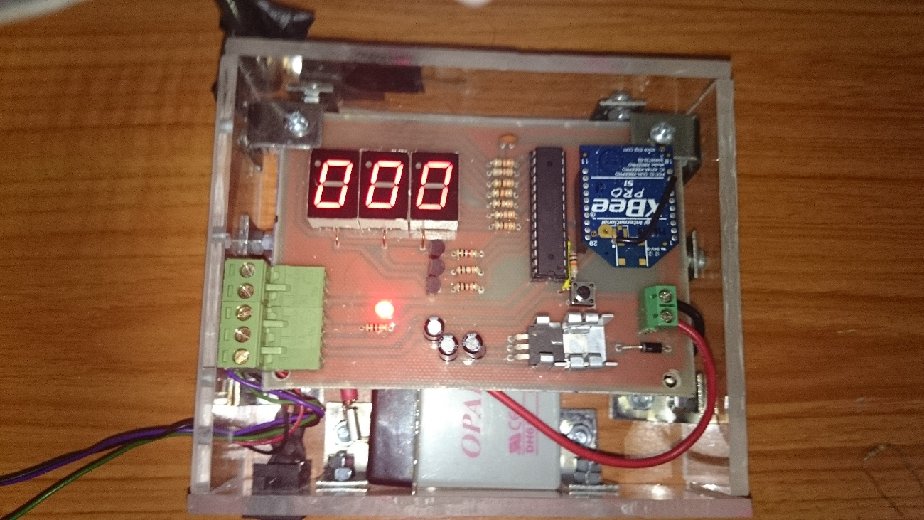
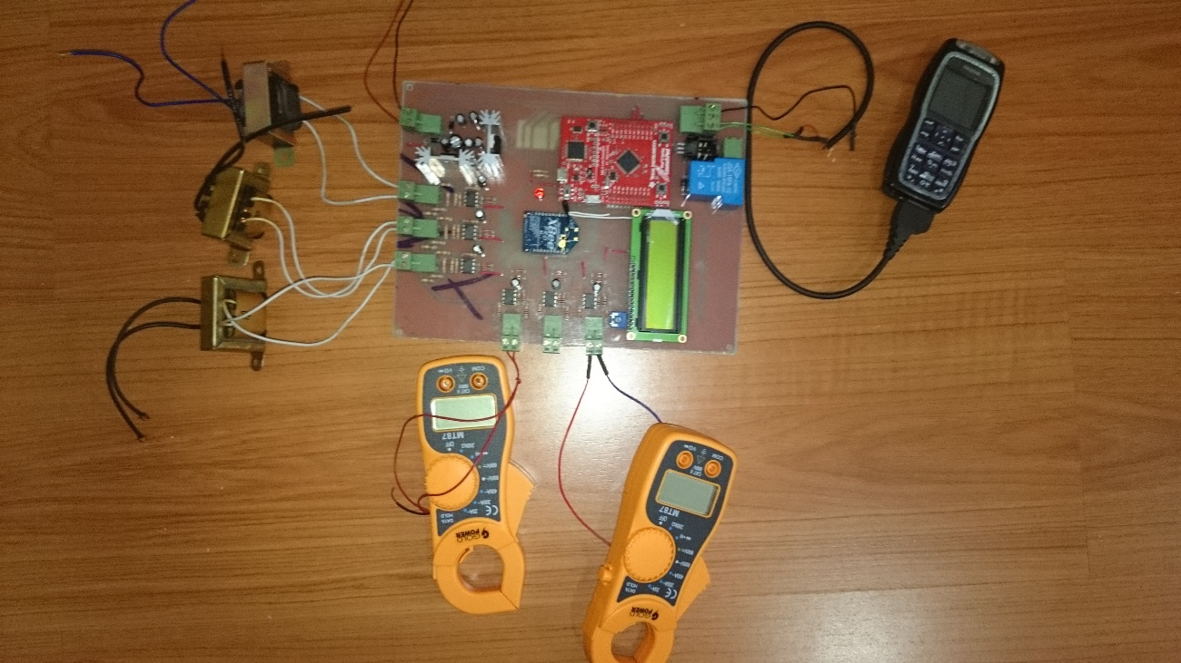
Design and Implementation of an Affordable Wind Turbine Monitoring System
By: Luis Chachayma
PROJECT OVERVIEW
Nowadays it is important to generate renewable energy, and wind turbines are an important source of renewable energy. The installation and operation of these systems is expensive and in order to afford them it is important to monitor them and prevent failures and expensive repair costs.
Monitoring systems are already used in the industry, but in a larger scale. In order to extend the usage of wind turbines we must have an economic monitoring system so people can afford this source of energy.
My project is an economic wind turbine monitoring system that can work in remote areas without internet access, it uses only a cellular network.
2nd Stage (Voltage and Current sensing, processing, and data transmission):
The voltage and the current were sensed with transformers and current clamps. Then, the data was processed with a Texas Instruments microcontroller (TM4123GH6PM).
Finally the processed data and the data received from the Anemometer was saved to a SD card. This information was also sent to the user if requested.
With the wind speed data and the power generated by the wind turbine, a performance range was obtained. In case the performance of the wind turbine was lower than the minimum, an alarm was sent to the user using GSM protocol (Text Message).
IMPLEMENTATION
1st Stage (Wind Speed sensing, processing, and data transmission):
To measure the wind speed an anemometer was fabricated and calibrated with a commercial anemometer. A DC motor was used to translate the rotational movement to electric signals.
The electric signals were processed with an Atmel microcontroller.
The data transmission was done with a Zig-Bee pro with a coverage up to 0.62 miles.
1st Stage Circuit
2nd Stage Circuit
Notes:
1

